Slide 1
Course Name (Section: X )
Project Presentation (Semester: Spring 24-25 )
Project Title: Automatic Street Light System
Group No: 05
Submission Date:1 June 2025
Group Members:
Roll No. | Student ID | Student Name
10 | 23-52980-3 | Rafid Hossain
11 | 23-52991-3 | Md. Abu Siam
13 | 23-53029-3 | Asma Akther
12 | 23-52993-3 | Zihad Bin Rahim
9 | 23-52979-3 | Linda Maria Gomes
3 | 23-50839-1 | Md. Zihad Khan
Lab Instructor: Dr Nadia Afroze
Lab Demonstrator: MD. Shahin Islam

Slide 2
Outlines of the project
Aims & Objectives
Introduction
Methodology
Results
Discussion
Conclusion
References

Slide 3
1. Aims & Objectives
To design a sensor-based circuit that can detect ambient light levels using an LDR (Light Dependent Resistor).
To automatically switch ON the streetlight when the surrounding light intensity falls below a certain threshold (e.g., during dusk or cloudy weather).
To switch OFF the streetlight automatically during daylight hours to conserve energy.
To reduce human effort and operational costs involved in manual switching of streetlights.
To demonstrate a prototype model of the system with proper component integration and functioning.
To ensure the system is energy-efficient, reliable, and suitable for real-world outdoor implementation.

Slide 4
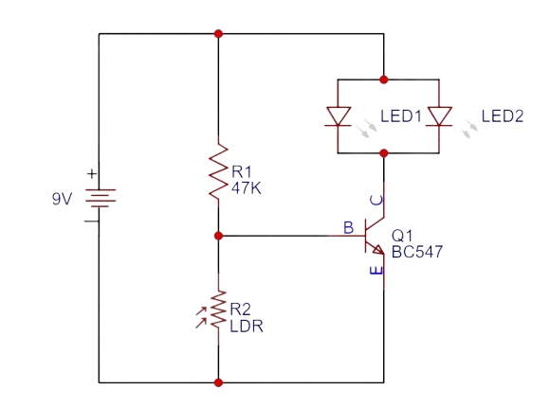
2. Introduction
In today’s world, automation plays a key role in improving efficiency, saving energy, and reducing manual effort. Street lighting is one area where automation can prevent unnecessary power consumption caused by manual switching or fixed timers. This project aims to develop an Automatic Street Light System that operates based on ambient light conditions using a Light Dependent Resistor (LDR).
The LDR senses the surrounding light level, and when it drops below a set threshold—like during dusk or nighttime—the system automatically turns ON the streetlight. When sufficient daylight is detected, the light switches OFF. This smart, energy-efficient system uses simple and cost-effective components, making it ideal for both urban and rural applications to promote sustainable energy use.
Figure 1: Circuit Diagram

Slide 5
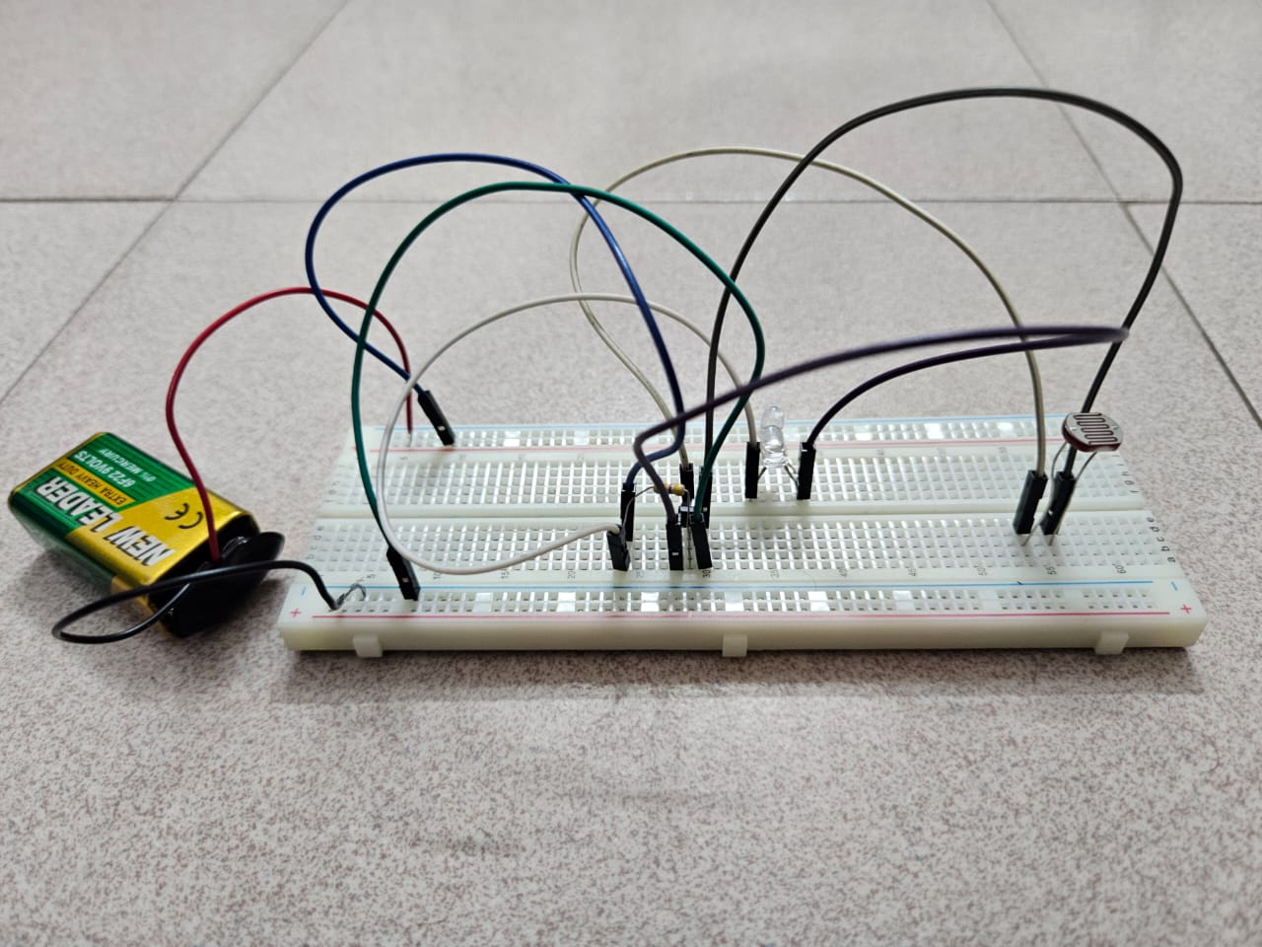
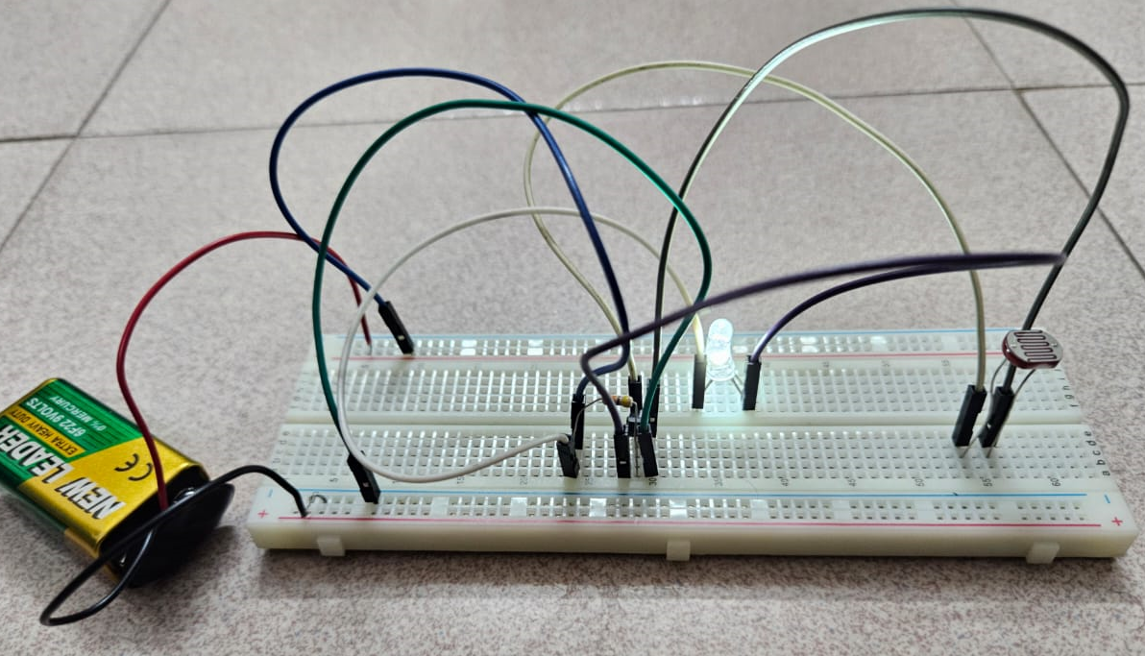
3. Methodology
Light Sensing: The LDR detects ambient light intensity and generates a voltage signal that decreases as the surrounding light fades.
Transistor Switching: The BC547A transistor receives the voltage signal from the LDR through a voltage divider. When it gets dark, the reduced voltage at the base allows the transistor to conduct.
LED Activation: In low light or darkness, the transistor switches ON, allowing current to flow through the LED, which lights up. In bright light, the transistor remains OFF, keeping the LED off.
Testing: The circuit was tested in various lighting conditions (daylight, shade, and complete darkness) to verify that the LED activates accurately in the absence of light.
Figure 2: Hardware Demonstration (In Daylight)
Figure 3: Hardware Demonstration (In Darkness)
Notes:
"Now I’ll explain the methodology behind our Automatic Streetlight System.
First, we have the Light Sensing component. This is handled by an LDR, or Light Dependent Resistor. The LDR detects the surrounding light intensity and generates a voltage signal. As the light level drops—like during evening or in darkness—the voltage across the LDR decreases.
Second, we use Transistor Switching to respond to the LDR signal. The transistor we’ve used is a BC547A. It acts like an electronic switch. When it receives the low voltage signal from the LDR, it turns ON. This happens through a voltage divider circuit that controls the transistor’s base.
Third, we get to LED Activation. When the transistor turns ON due to low light, it allows current to flow to the LED, which then lights up. So in darkness, the LED is ON. But in bright light, the transistor stays OFF, and the LED remains OFF too.
Finally, for Testing, we tested our circuit in various lighting environments—like daylight, shade, and complete darkness—to make sure the LED responds correctly. The goal was to ensure that the LED only turns ON when there's not enough light.
As you can see in Figure 2, the LED is OFF in daylight, and in Figure 3, the LED turns ON in darkness—demonstrating the circuit works as expected."

Slide 6
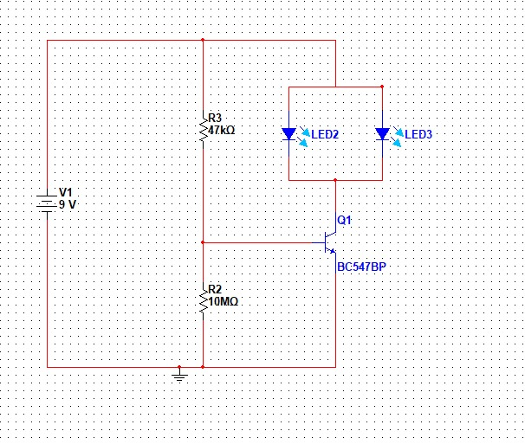
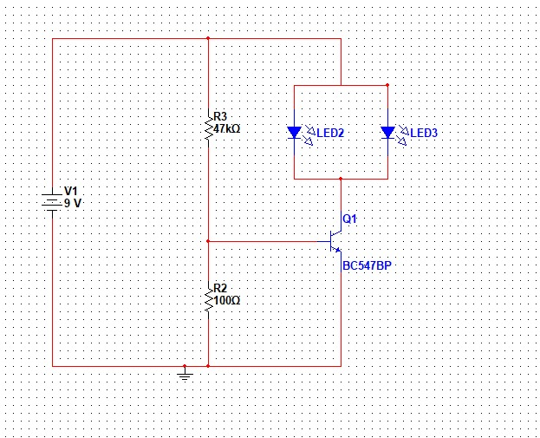
4. Results
The automatic street light system successfully detected changes in ambient light using the LDR sensor.
The streetlight (represented by an LED) turned ON automatically in low-light conditions (e.g., darkness or shadow).
The LED turned OFF automatically in bright light conditions (e.g., sunlight or strong artificial light).
The system responded accurately and promptly to changing light levels without the need for manual control.
Power consumption was reduced, as the light only operated when necessary.
The prototype demonstrated reliable and consistent performance during multiple tests under different lighting environments.
Figure 4: Simulated Diagram
Figure 5: Simulated Diagram
Notes:
The automatic street light system effectively detected changes in ambient light using an LDR sensor. It successfully turned LEDs ON in low-light conditions and OFF in bright environments without manual input. This automation led to reduced power consumption, as the light operated only when necessary. Furthermore, the prototype proved to be reliable and consistent across various lighting conditions during repeated testing, as confirmed by the simulated circuit diagrams shown in Figures 4 and 5.

Slide 7
5. Discussion
The Automatic Street Light System worked effectively by turning the LED on in low light and off in bright conditions. The LDR senses ambient light, and its resistance changes accordingly. In darkness, the increased resistance causes the transistor (BC547P) to switch ON, allowing current to light the LED. In bright light, the transistor stays OFF, and the LED remains off. Testing under various conditions confirmed reliable and accurate switching. The circuit is simple, cost-effective, and suitable for real-life applications like automatic night lights and solar garden lighting.
Notes:
The Automatic Street Light System worked exactly as expected. It successfully turned the LED ON when the surrounding light was low or absent, and turned it OFF in bright conditions.
This behavior is controlled by the LDR, which detects the ambient light. As it gets darker, the LDR's resistance increases. This change triggers the BC547P transistor to switch ON, allowing current to flow and power the LED.
In daylight, the resistance of the LDR decreases, so the transistor stays OFF and the LED also remains OFF.
We tested the system in various lighting conditions—such as daylight, shade, and complete darkness—and the switching was always reliable and accurate.
As we know from this project that the main advantage of this circuit is its simplicity, low cost, and efficiency. It’s not only useful in street lighting but can also be applied in real-world systems like automatic night lights, solar garden lighting, or even smart home systems."
In advanced systems, photodiodes or phototransistors may replace LDRs due to faster response and better sensitivity, but LDR-BJT circuits remain a useful entry-level or fallback solution.

Slide 8
6. Conclusion
The Automatic Street Light System was successfully designed and implemented using an LDR and a BC547 transistor. The system effectively responded to changes in ambient light, turning the light ON in darkness and OFF in daylight without any manual intervention. This project demonstrates a simple, low-cost, and energy-efficient solution for automating street lighting.
By reducing unnecessary power consumption and human effort, this system contributes to energy conservation and can be scaled for real-world applications. The project also highlights how basic electronic components can be used to build functional and practical automation systems. Future improvements can include features like motion sensors, timers, or solar power for enhanced efficiency and Sustainability

Slide 9
7. References
Boylestad, R. L., & Nashelsky, L. (2009). Electronic Devices and Circuit Theory (11th ed.). Pearson Education.
Chapter 3: Diodes and Applications
Electrical Technology. (2013, April). Automatic Street Light Control Circuit using LDR & Transistor. Retrieved from (Electrical Technology)
Easy Electronics Project. (2020, April 15). Automatic Street Light with LDR. Retrieved from (Electronics Projects)
ElectronicWings. (2020, September 29). Automatic Street Light Controller. Retrieved from (ElectronicWings)
TRONICSpro. (n.d.). How to Make Automatic Street Light Controller. Retrieved from (TRONICSpro)

Slide 10

Thanks for listening

